Slide 1
Php and mysql

Slide 2
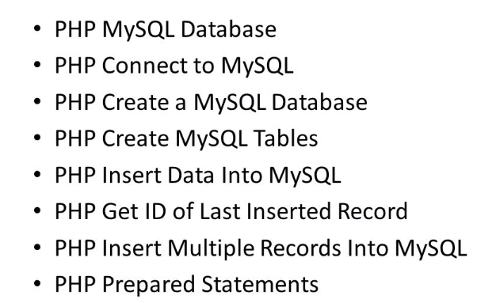
Outline

Slide 3

Outline

Slide 4
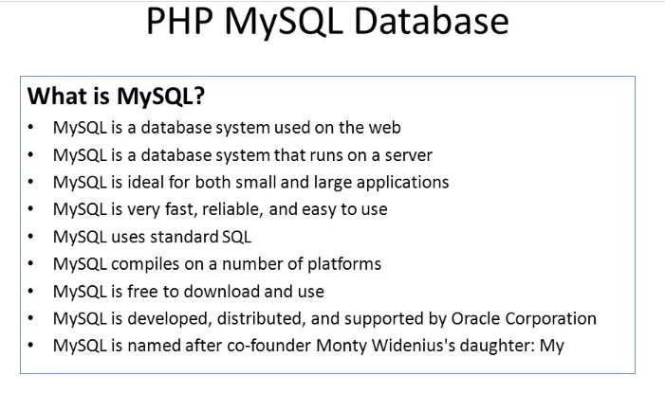

Slide 5
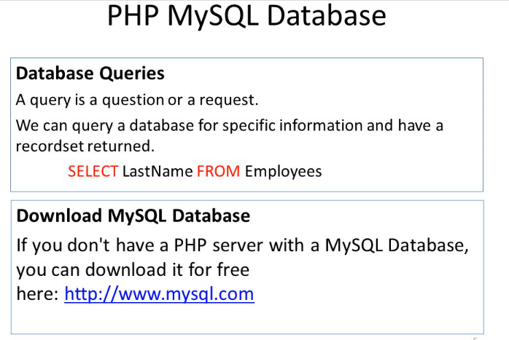

Slide 6
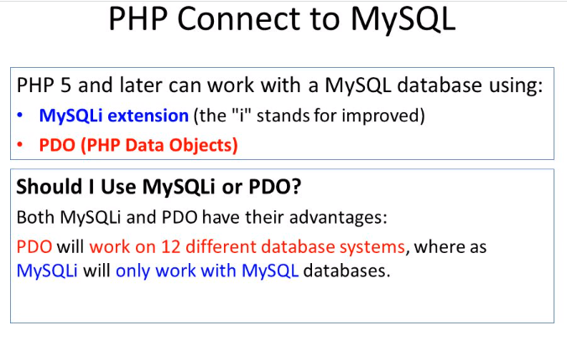

Slide 7
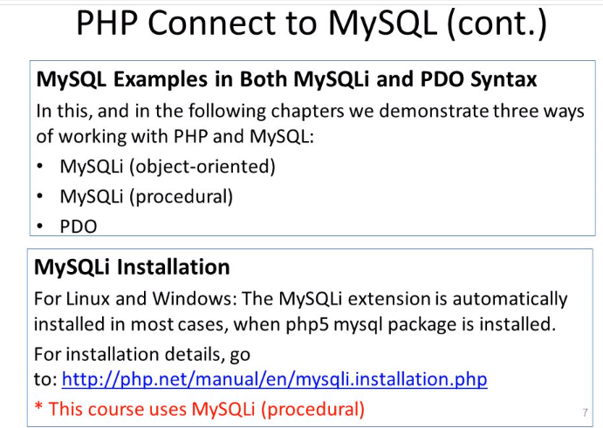

Slide 8
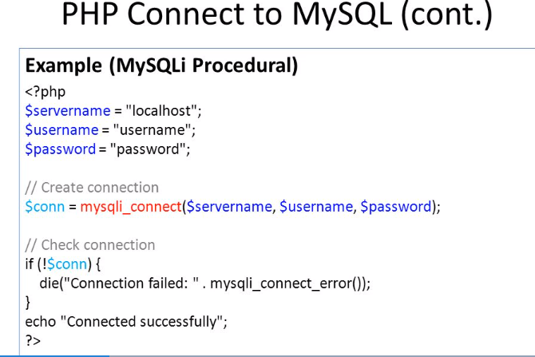

Slide 9
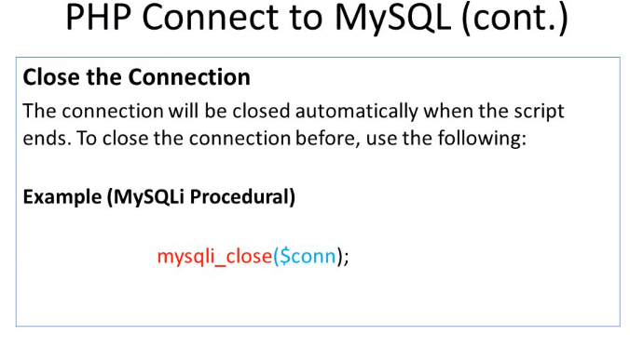

Slide 10
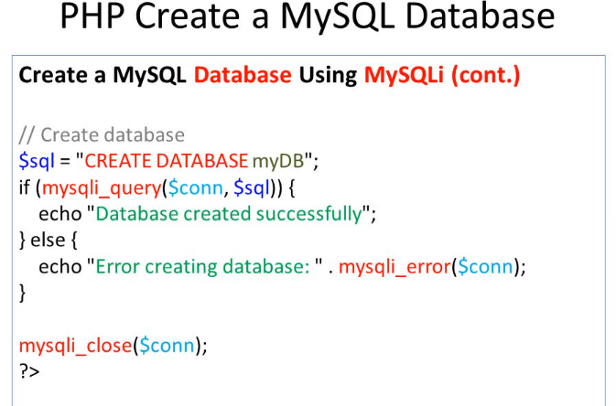

Slide 11
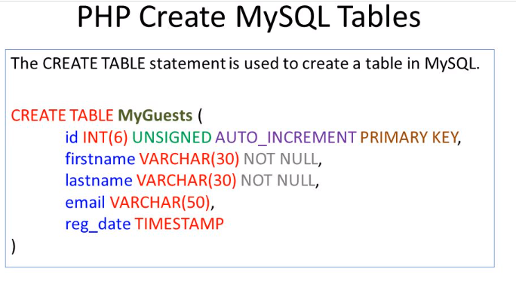

Slide 12
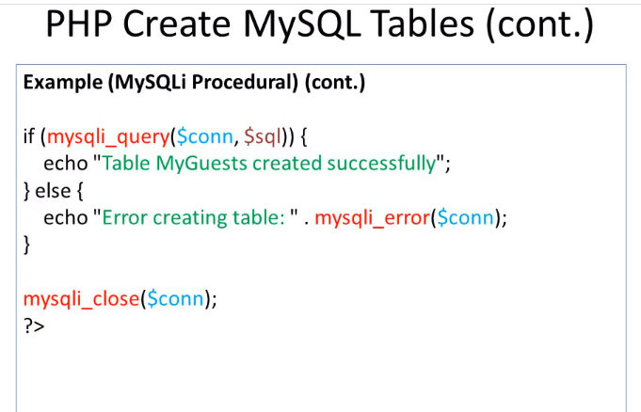

Slide 13
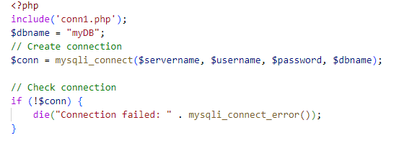
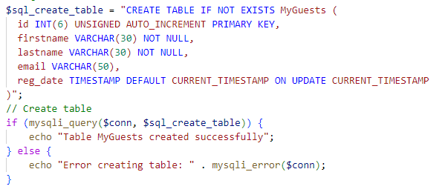

Slide 14
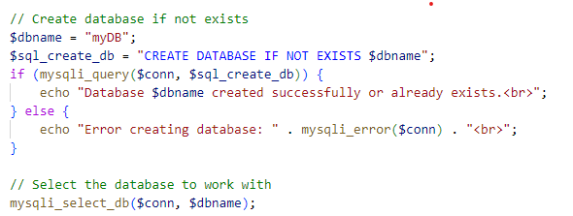

Slide 15
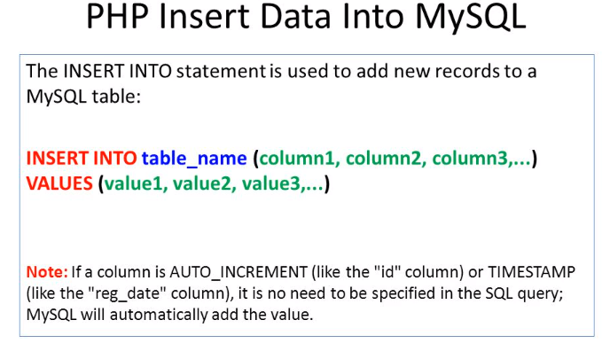

Slide 16
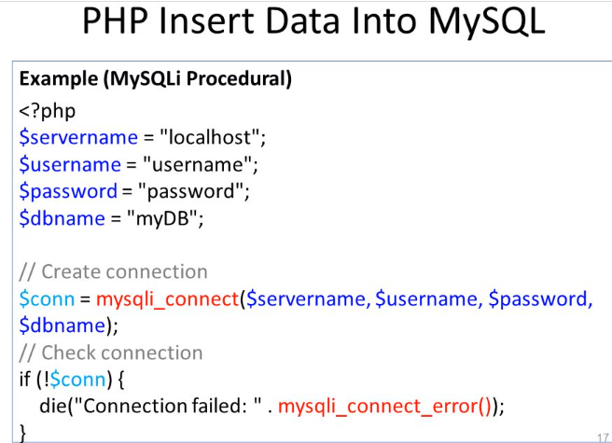

Slide 17
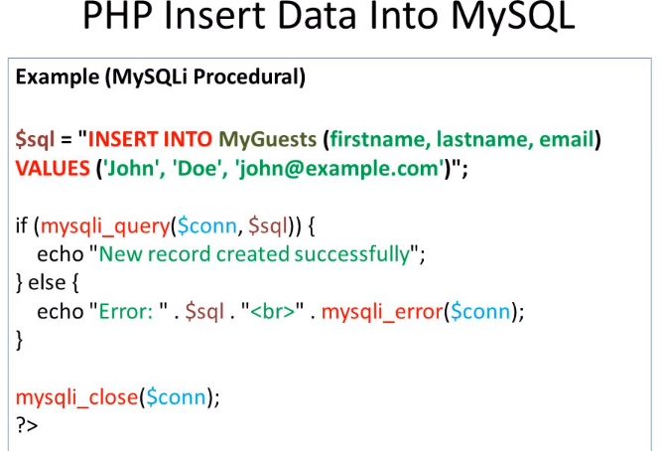

Slide 18
Insertion of multiple records
1. Using mysqli_multi_query()
The mysqli_multi_query() function allows you to execute multiple SQL queries in one call, separated by semicolons. It is typically used for executing several queries (including INSERT statements) in one go.

Slide 19
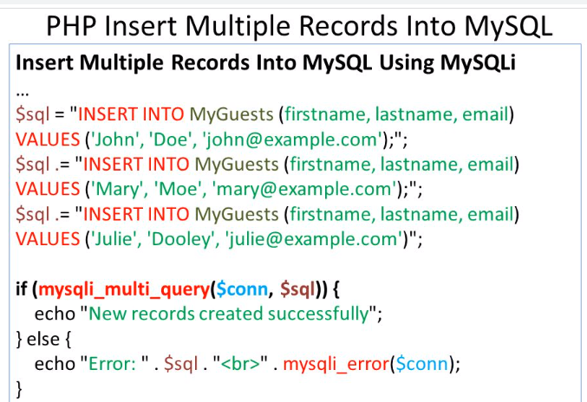

Slide 20
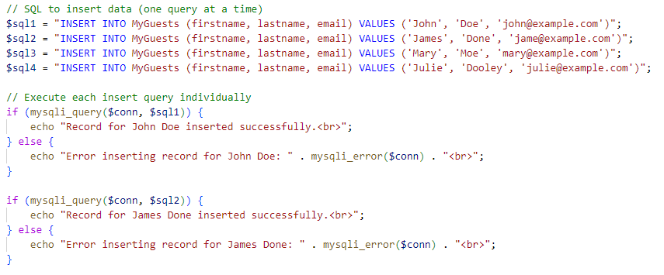
Insertion of multiple records
2. Using Multiple Variables
You can also create multiple SQL INSERT queries and execute them one by one by storing them in separate variables. While this isn't the most efficient way for a large number of records, it's a simple method for smaller datasets.

Slide 21
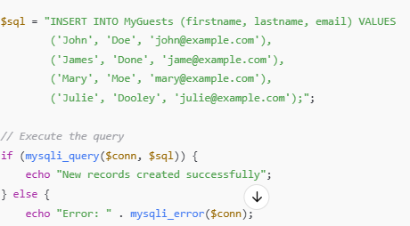
Insertion of multiple records
3 Using a Single INSERT Query for Multiple Records

Slide 22
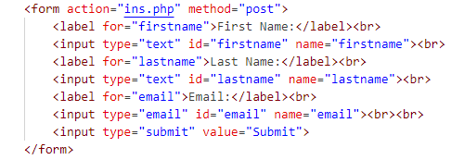
Insert form data in my sql
an html form is created in index.html

Slide 23
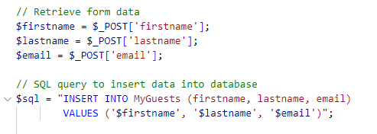
Insert.php
than include connection.php and create table.php
Than retrieve data insert data and execute mysqli query using mysqli_query($conn,$sql);

Slide 24
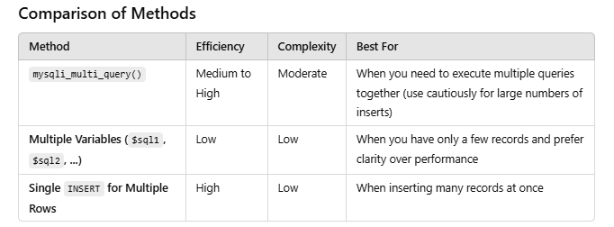

Slide 25
if the connection is closed in conn.php, including conn.php in other files like create_table.php or insertion.php could either cause multiple connections or errors when trying to use the connection
To handle this properly, you need to make sure that the connection is only established once, and is reused across all files without being closed prematurely.
The most straightforward approach is to avoid closing the connection in conn.php. By leaving the connection open, all files that include conn.php can use the same connection without re-establishing it.
If you want to use the connection globally, you can define the connection as a global variable, which can then be accessed across multiple files without the need to pass it explicitly.

Slide 26
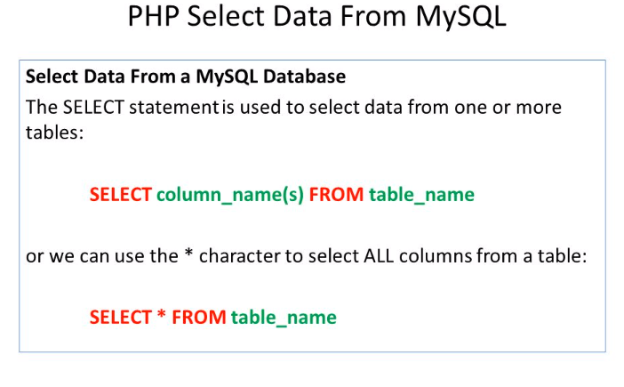

Slide 27
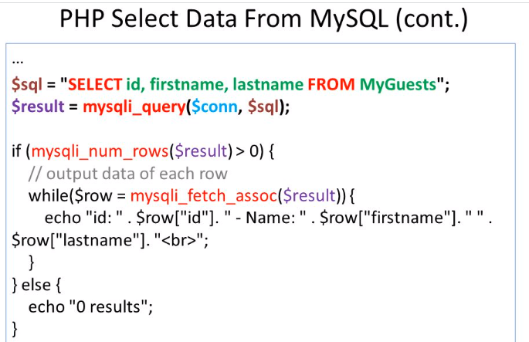

Slide 28
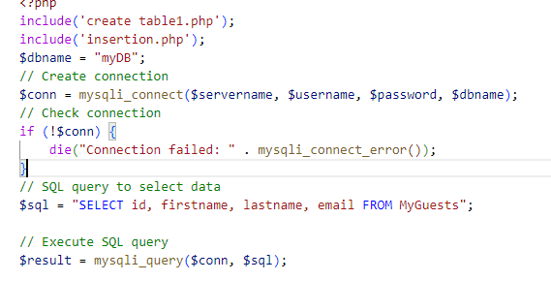
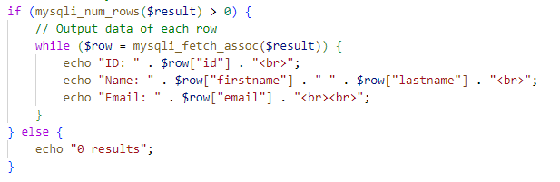

Slide 29
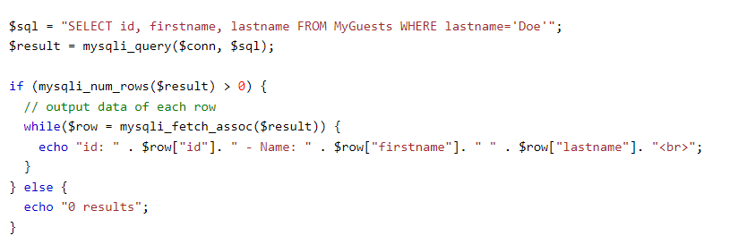
Select and Filter Data From a MySQL Database
SELECT column_name(s) FROM table_name WHERE column_name operator value

Slide 30
Select and Filter Data From a MySQL Database
SELECT column_name(s) FROM table_name WHERE column_name operator value

Slide 31
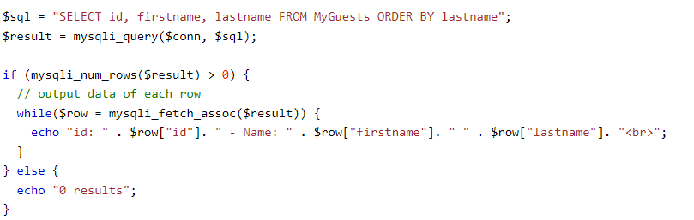
Select and Order Data From a MySQL Database
SELECT column_name(s) FROM table_name ORDER BY column_name(s) ASC|DESC

Slide 32
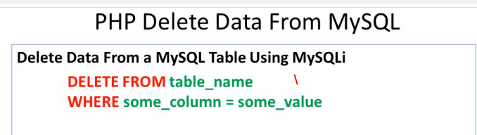


Slide 33
